Slide 1
Site Collection Templates and Site Designs
Speaker Name

Slide 3
Objectives
After completing this lesson, you will:
Know SharePoint Site Templates (Classic and Modern Site Templates)
Understand Modern site templates
Know reasons for provisioning a Team site versus a communication site
Notes:
Introduction
This lesson introduces you to site templates and designs that are available for creating site collections in SharePoint Online
Objectives
After completing this lesson, you will:
Understand Classic Site templates
Understand Modern site templates and designs
Know reasons for provisioning a Team site verses a communication site
Understand moving from Publishing sites to Communication sites

Slide 4
SharePoint Online site templates
SharePoint provides site templates that you can use to create your site collections:
A site template is a blueprint for a site and represents the final design of the site.
Site templates contain lists, libraries, pages, and other elements or features that support the needs of an organization.
Template’s content is based on the site collection’s intended use
SharePoint provides two categories of site templates
Classic Site Templates (Legacy)
Modern Site Templates (Recommended)
Notes:
When you create a site collection or sites within a site collection, SharePoint provides you with the option of choosing a site template. A site template is prepopulated with lists, libraries, pages, and other elements or features that support the needs of an organization.
When you create a new site collection or site by using a template you can start using the site right away, or you can customize the site so that it meets the needs of your team, event, or your larger organization.
When a new site collection or sub-site is created in SharePoint Online, a site template (to base the site on) is first selected (by either an admin, an end-user, a script or program creating the site).
Prior to modern methods of site design and customization being made available, a common practice was to customize (and/or save/re-use edited versions of) classic site templates to provide desired starting points contain necessary branding, layouts, and site elements.
For classic-type sites, these methods are now strongly discouraged (in favor of remote, post-provisioning of desired customizations).
For modern sites/experiences, new site designs and scripts are the recommended path moving forward (modern site template customization is not possible).

Slide 5
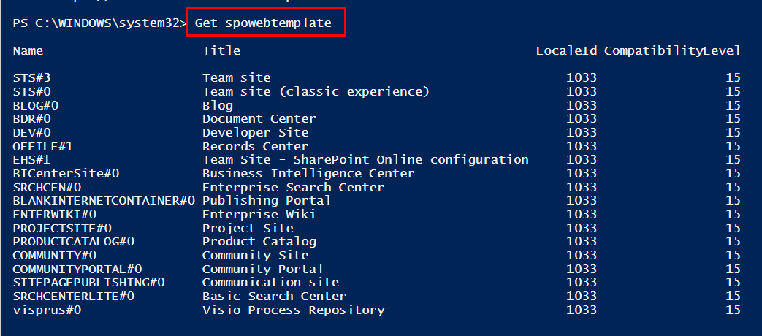
SharePoint Online site templates

Slide 6
Classic vs. Modern site templates
Classic (not covered in this class):
Not Mobile friendly
Hours of “development” time
Heavy reliance on branding to “not look like SharePoint”
No future investments from Microsoft on Classic features
Modern:
Responsive for different screen sizes including tablet and mobile
Easy to build by large user base in the business
Pages that look great with little work
Tools from Microsoft to modernize
Investments made to modern

Slide 7
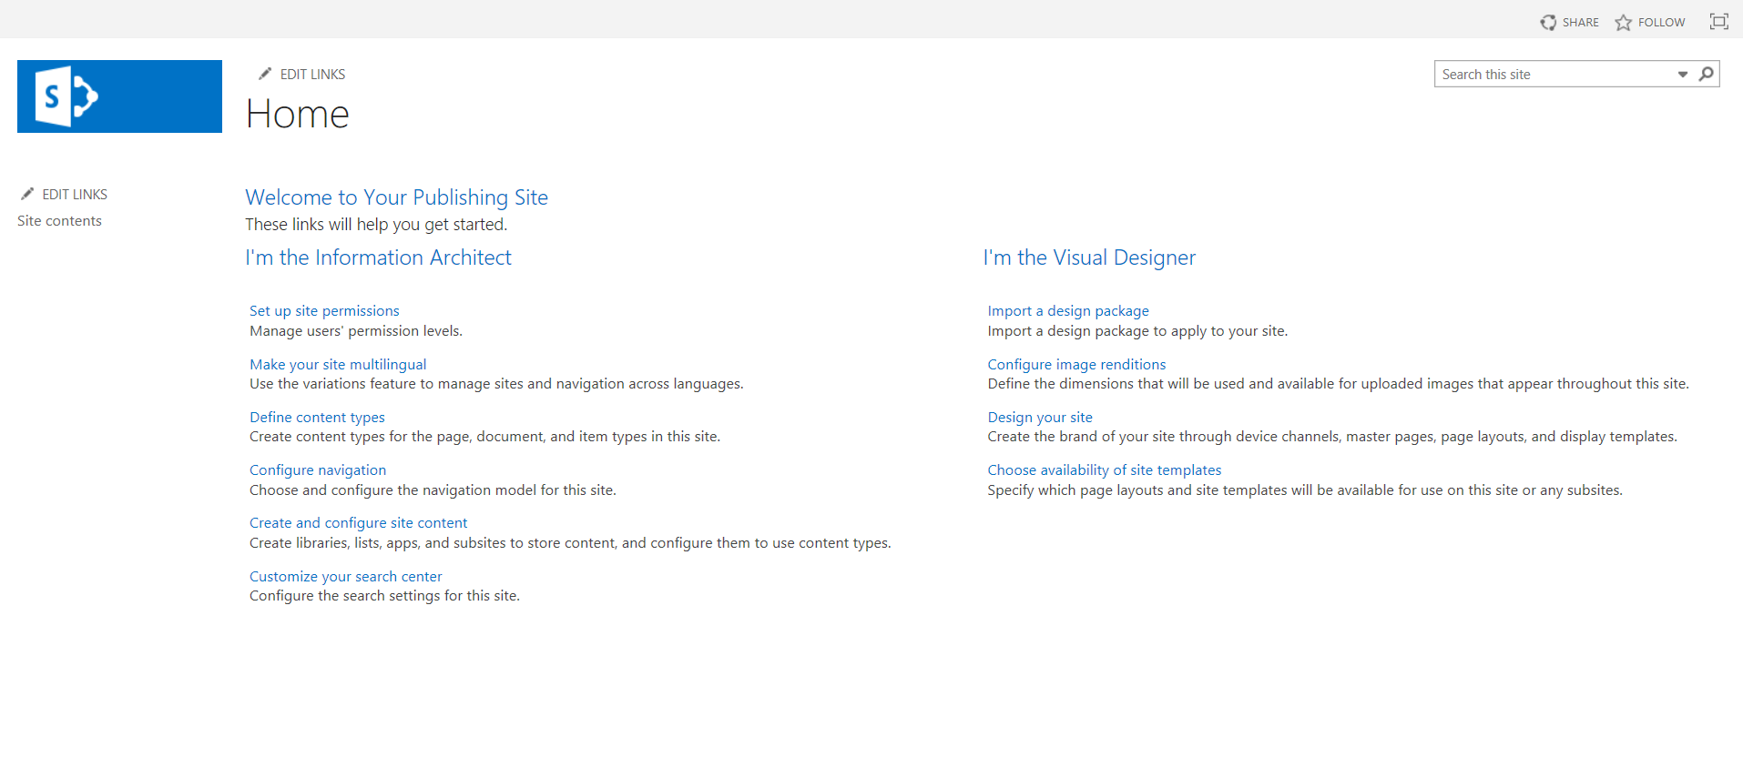
Publishing site template (Classic)
A SharePoint “classic” site using a publishing template
Structured process for
Authoring
Content Management
Approvals
Allows the authors to be “working” on a page without audience seeing the results until published
Tight level of control by a small number of people
This module will not use publishing sites, but you may have them in your organization.
The new Communication site template is recommended
No new investments from Microsoft done for Publishing or “classic” features
Notes:
Publishing features
-----------------------
Here are the features that are available once publishing is enabled in a SharePoint Online site collection. Some features are prominent on the ribbon, while others are visible only through the links on the Site Settings page or libraries.
Navigation and ribbon
--------------------------
When you edit a page in the Edit group of the Format Text tab on the ribbon you’ll find Check In/Check Out buttons that allow you to edit the page content while maintaining version control. This feature is available on both the Publishing Portal and Enterprise Wiki.
On sites that use approval workflows, the Publish tab includes Publish, Approve, and Reject buttons. These are all part of the approval workflow that ensures nothing is published on your site without the approval of designated reviewers. There's also a Quick Deploy button which publishes the next time content is published. The Publish button lists several options, including Submit, which kicks off the workflow by routing the current page to one or more approvers for review. You can also can cancel approval or unpublish a page from here, depending on your permissions.
The Schedule button opens a dialog box where you can specify when the page should be published and when, if ever, it should be retired.
Approval workflows and scheduling are not available for public-facing website collections.
Lists and libraries
--------------------
Important:
Beginning in October 2018 the Site Content and Structure is being deprecated in SharePoint Online. The UI entry point to the SiteManager.aspx will be removed from SharePoint Online and direct access will be restricted to Site Collection Admins until March 2019.
SharePoint Online provides a number of advanced capabilities to support managing a sites content and structure. For more information about how to move and copy files in a document library in SharePoint, see:
If you haven't yet started using the modern List / Library experiences then setting up and using your computer to sync content locally for copy and move purposes is an option . For more information, see Set up your computer to sync your OneDrive for business files in Microsoft 365.
"User interface" section of Modern document libraries in SharePoint
Copy files and folders between OneDrive and SharePoint sites (included File Copy and Move for SharePoint Document Libraries)
When you enable the publishing infrastructure feature, a set of lists and libraries is added to your publishing site at the site collection level. You'll find the Site Content and Structure tool under Site Settings > Site Administration > Content and Structure
Content and Structure Reports list Lets you customize the queries that appear in the View list in the Site Content and Structure tool.
Reusable Content list Contains HTML or text content that can be inserted into webpages.
Site Collection Documents library Stores documents that are used throughout the site collection.
Site Collection Images library Stores images that are used throughout the site collection.
In addition, four libraries have been added at the site level for storing site content. You'll find these in Site contents:
Pages library Stores site pages.
Images library Holds images used on site pages.
Documents library Contains all documents used on site pages.
Workflow tasks Stores the workflow tasks that are created for the site.
Web parts
--------------
Publishing sites include a variety of web parts that enable authors to insert video, rich text, forms, and dynamic content onto a site page. You'll find these Web Parts under Insert > Web Part > Categories. These three web parts, which are unique to publishing sites, are available at the site collection level and for all subsites in the site collection:
Content Query Web Part Displays a dynamic view of content on your site based on a query you build within the properties pane of the web part. This is under the Content Rollup category.
Summary Links Web Part Allows authors to create links that can be grouped and styled. This is under the Content Rollup category.
Table of Contents Web Part Used to automatically generate a directory that points to various parts of your site collection. This is under the Content Rollup category.
Master pages, page layouts, content types, and columns
---------------------------------------------------------------
Master pages and page layouts dictate the overall look and feel of your SharePoint site. Master pages contain controls that are shared across multiple page layouts, such as navigation, search, or language preference for multilingual sites. Page layouts contain field controls and web parts. Page layouts and master pages work together to create the layout for a webpage.
In a publishing site, the master page is updated to include a Publishing tab, where you can find the scheduling and workflow buttons shown earlier in this article. Along with the updated master page come the following elements.
Content types - The Publishing Portal publishing portal template includes Article Page, Project Page, Welcome Page, Enterprise Wiki Page, Rollup Page, and Redirect Page.
Page layouts - Image on Left, Image on Right, and Splash. These page layouts are automatically associated with the content types mentioned above when the publishing features are enabled. For the Enterprise Wiki, page layouts include Basic Page, Basic Project Page, and Redirect Page.
Columns - Page layout columns are Byline and Page Content.
Publishing columns added at the site collection level are Article Date, Scheduling Start Date, and Scheduling End Date.
A custom Wiki Categories column that uses managed metadata for Wiki pages is also added at the site collection level.

Slide 8
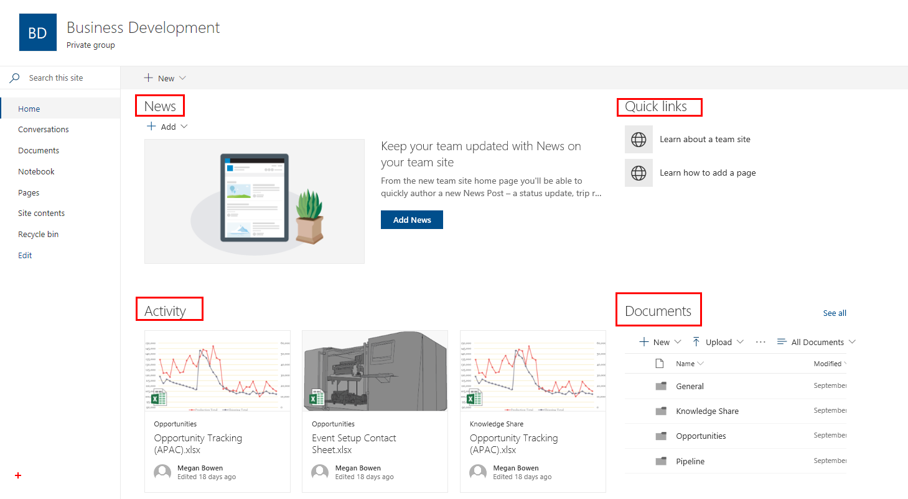
Modern Team sites
Recommended versus classic team site
Designed to scale for any device natively without customizations for a fully responsive experience.
Contain native news, quick links, and activity capabilities.
Can be integrated with Microsoft 365 groups
Significantly faster site creation compared to "classic" team sites.
Include modern lists and libraries with native integration for Microsoft Flow and PowerApps.
Contain "modern" page editing capabilities.
Include an updated site contents page with additional insights on site usage.
Notes:
Supported customizations on "modern" team sites
"Modern" sites have a different level of customization options compared to "classic" team sites. Over time we'll introduce additional customization options, mainly focusing on extensibility and branding. The following list gives a quick overview of the supported capabilities for "modern" team sites. You can:
Apply a custom theme or change the logo.
Apply an out-of-the-box theme.
Create custom site columns (fields) and content types.
Create lists and libraries.
Configure site settings, such as regional settings, languages, and auditing settings.
Note
By default, a "modern" team site has scripting capabilities turned off. You can still apply a custom theme, but you cannot introduce a custom theme to the theme gallery as an option for end users. If you want to add a theme to the theme gallery, you need to enable scripting on the site.
What's not supported on "modern" team sites
In numerous areas on the "modern" team sites, the typical customizations are not currently available. Further support will be available for some of these topics when they are ready to be released. Following is a list of currently unsupported customizations on "modern" team sites:
Custom master pages; more extensive branding will be supported later using alternative options.
Changing "modern" site to use "classic" seattle.master or oslo.master.
Custom page layouts; we are looking to have support for multiple canvases in the future.
Enabling site or site collection scoped publishing features; technically, features can be currently activated, but this is not a supported configuration.
User custom actions / custom JavaScript; there will be a more controlled way to embed JavaScript on the pages through the SharePoint Framework Extensions (currently in dev preview).
"Modern" subsites; subsites created on "modern" team sites use the "classic" experience, but you can change the user experience to be similar to "modern" sites.
Ability to control available subsite template options.
"Classic" publishing features (WCM).
Activation of community feature or creation of community subsites under "modern" team site.
Because "modern" team sites also have scripting capabilities disabled (it's a so called NoScript site), numerous areas cannot be customized. The impact of NoScript is the same for "modern" or "classic" sites. "Modern" sites have NoScript enabled by default, meaning that scripting capabilities are not available. However, it is possible and supported to disable NoScript settings in both "modern" and "classic" sites to further enable some capabilities.
When you design your solutions, consider these key areas related to the NoScript setting:
Sandbox solutions are not supported.
Custom JavaScript cannot be enabled on the sites by using "classic" extensibility options (for example, via user custom actions).
You cannot access sites using SharePoint Designer.
Some web parts are not available for end users.
Ability to access or update site property bag entries.
Note
You can find the full list of impacted capabilities from the Microsoft Support article Allow or prevent custom script under the "Features affected when custom script is blocked" section.
Using PnP provisioning engine with "modern" team sites
You can use the PnP provisioning engine with "modern" team sites. The PnP provisioning engine automatically detects if a site is a "modern" team site and adjusts its behavior based on the supported capabilities. The process is exactly the same as using the PnP provisioning engine with "classic" sites where the scripting capabilities are not disabled.
The following elements are ignored when a remote template is applied to a "modern" team site or a site that has NoScript enabled:
Site collection AuditLogTrimmingRetention configuration in the auditing settings
Applying a custom theme from the template; current implementation has a dependency on storing a custom theme to the catalog, which is not supported
Form settings for content types
Adding custom user actions to site, web, or list level
Adding files with file types of ".asmx", ".ascx", ".aspx", ".htc", ".jar", ".master", ".swf", ".xap", ".xsf"
Adding files to libraries with the following urls "_catalogs/theme", "style library", "_catalogs/lt", "_catalogs/wp"
Adding web parts to site pages
Storing provisioning template information to the property bag of the provisioned site
Adding or updating property bag entries to the site property bag
"Classic" publishing settings and assets
Site No Crawl settings
Site master page settings

Slide 9
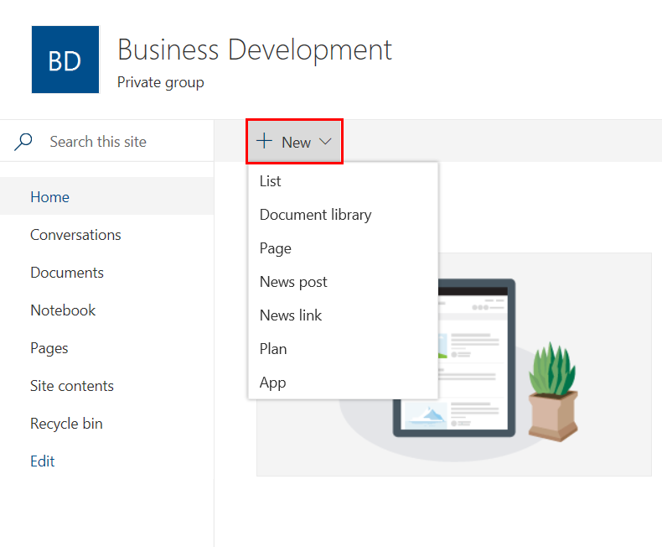
Modern Team sites - Create Panel
Create a List
Document library
Page
New Post
News Link
Plan
Add and App

Slide 10
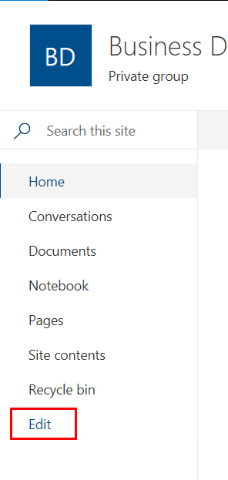
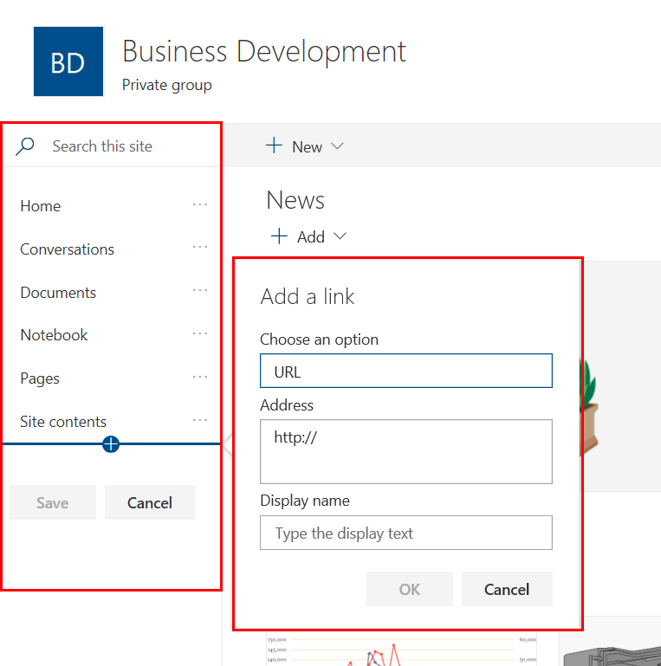
Modern Team sites - Navigation
Left navigation can be edited without having to navigate to the site settings page.
Click Edit at bottom of left navigation to add new navigation links, remove links, and to change the order of existing navigation links.

Slide 11
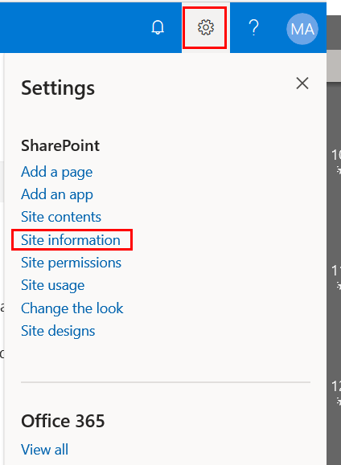
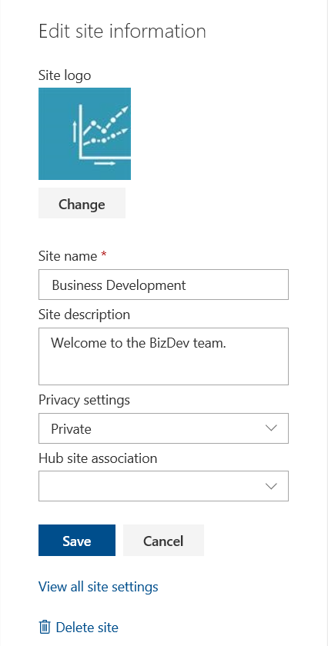
Modern Team sites - Site Information
Change the Site Name
Description
Privacy settings
Associate to a Hub site
and more

Slide 12
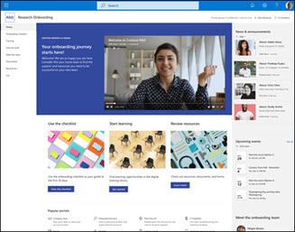
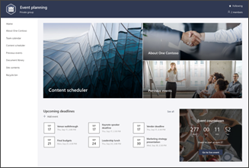
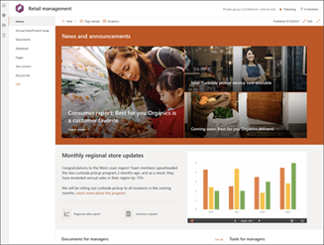
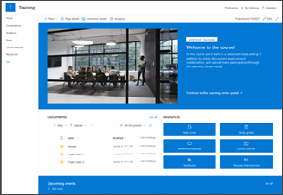
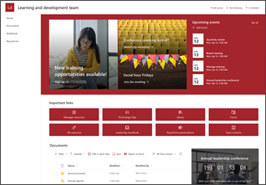
Modern Team sites – site templates
Available Templates:
Crisis Communication
Employee Onboarding
Event Planning
IT Help Desk
Project Management
Retail Management
Store collaboration
Syntex Contracts Management
Team Collaboration
Training and Courses
Training and Development team

Slide 13
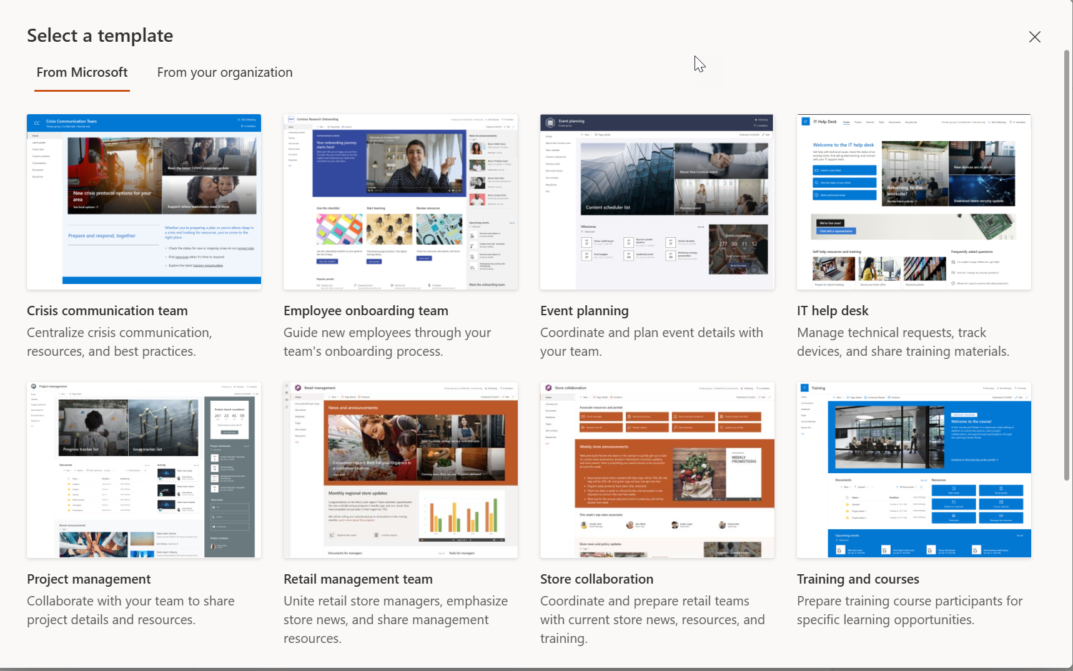
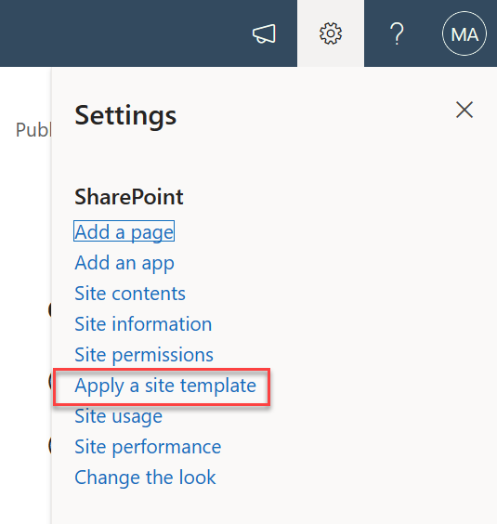
Site Template
Select Setting gear
Apply Site template
Pick from Microsoft templates or from your organization.

Slide 14
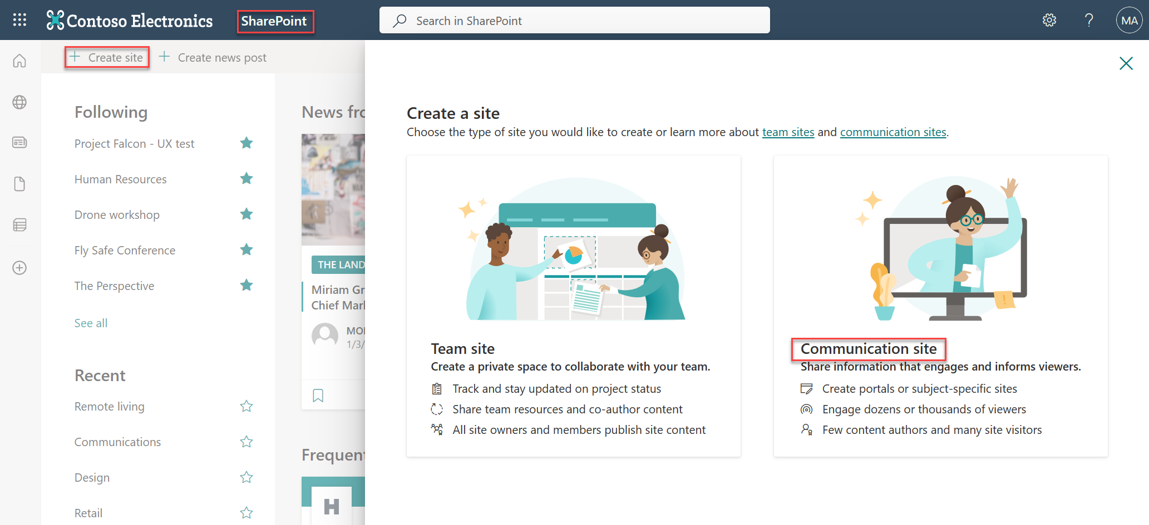
Communication site (Modern)
Recommended versus classic publishing site
A great place to share information with others
Share news, reports, statuses, and other information in a visually compelling format.
Not Microsoft 365 Group connected
Notes:
What does a communication site include?
When you create a communication site in SharePoint Online, you can start with a blank site or choose one of the other site designs, each of which comes with a default set of web parts. The options available are:
Topic to share information such as news, events, and other content.
Showcase to use photos or images to showcase a product, team, or event.
Blank to create your own design.
No matter which one you choose, you can add, remove, or reorder web parts as needed.
If you have permission to edit the site, there's also a link at the top of the communcation site to add a new list, document library, page, news post, or web app to the site.
Topic
When you choose the Topic design, you get a home page that includes several web parts ready for you to customize. The web parts included by default on a Communication site that uses the Topic design are:
Hero: Use the Hero web part to bring focus and visual interest to your page. You can display up to five items in the Hero web part, and you can add compelling images to draw attention to each. For more information, see Use the Hero web part on a modern page.
News: You can keep your team in the loop as well as engage them with important or interesting stories by using the News web part. For more information, see Use News Headlines and News List web parts on a modern page.
Events: Display upcoming events using the events web part. For more information, see Use the Events web part.
Highlighted content: Use the Highlighted content web part to dynamically display content from a document library, a site, a site collection, or all sites. By default, this web part shows your most recent documents. For more information, see Use the Highlighted content web part.
Showcase
The Showcase design also comes with a home page that includes several web parts ready for you to customize. Here are the web parts included by default on a Communication site that uses the Showcase design:
Hero: Use the Hero web part to bring focus and visual interest to your page. With the Showcase design, you can choose from two layouts, Tile and Layer, and add compelling images to draw attention to each item. For more information, see Use the Hero web part on a modern page.

Slide 15
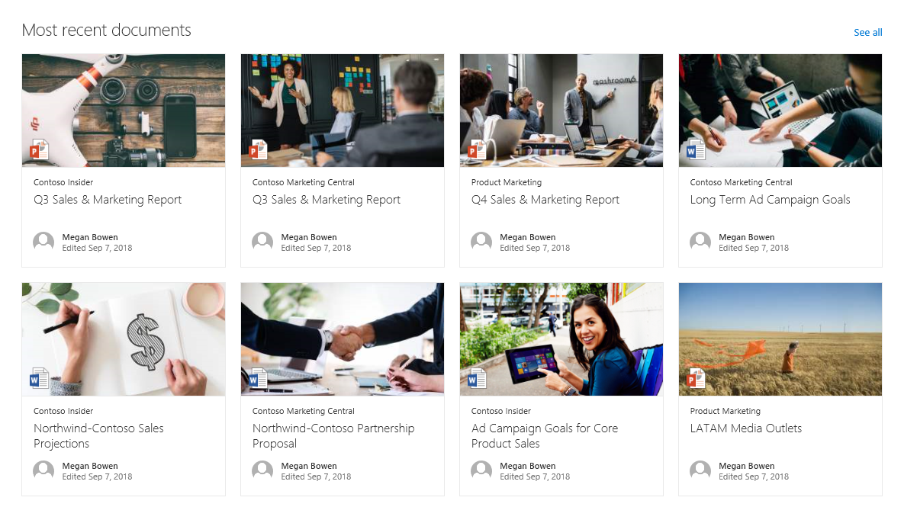
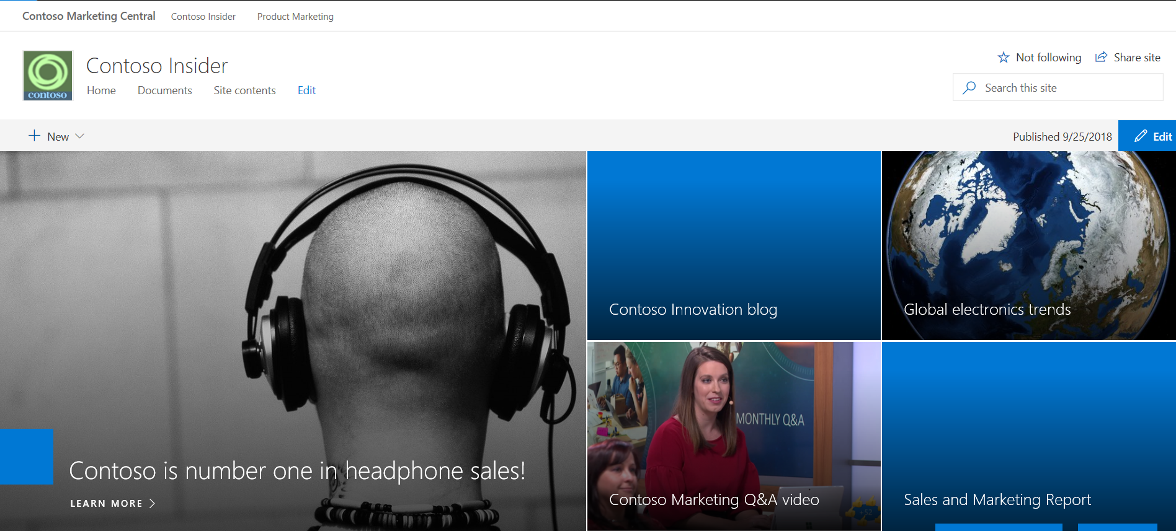
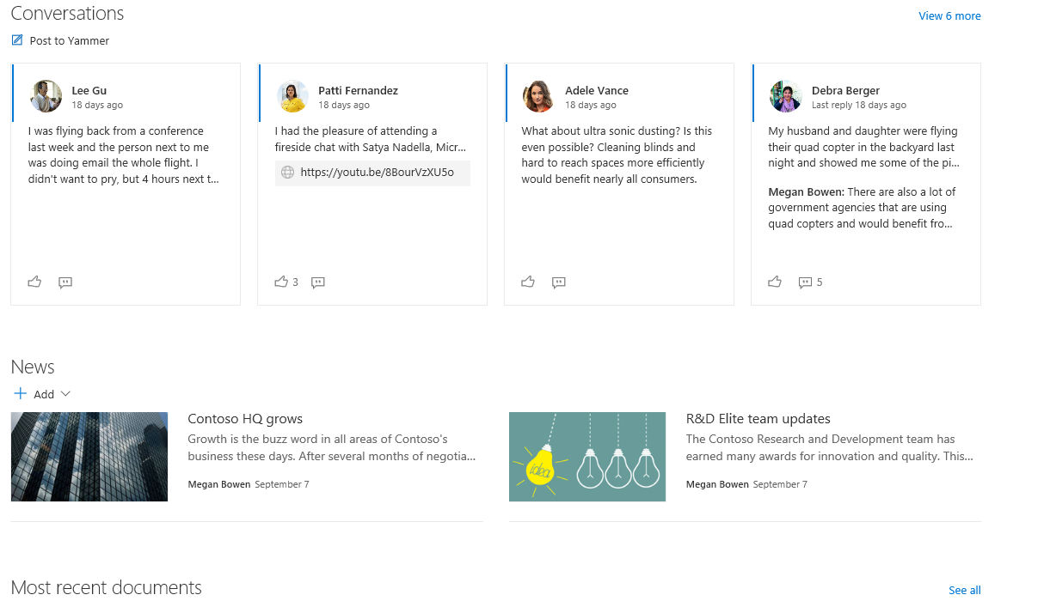
Communication site
Use the Hero web part to bring focus and visual interest to your page.
Display up to five items in the Hero web part
Keep everyone in the loop and engage your audience with important or interesting stories by using the News web part on your page or site.
Use the Highlighted content web part to dynamically display content from a document library, a site, a site collection, or all sites.
Notes:
What does a communication site include?
When you create a communication site in SharePoint Online, you can start with a blank site or choose one of the other site designs, each of which comes with a default set of web parts. The options available are:
Topic to share information such as news, events, and other content.
Showcase to use photos or images to showcase a product, team, or event.
Blank to create your own design.
No matter which one you choose, you can add, remove, or reorder web parts as needed.
If you have permission to edit the site, there's also a link at the top of the communcation site to add a new list, document library, page, news post, or web app to the site.
Topic
When you choose the Topic design, you get a home page that includes several web parts ready for you to customize. The web parts included by default on a Communication site that uses the Topic design are:
Hero: Use the Hero web part to bring focus and visual interest to your page. You can display up to five items in the Hero web part, and you can add compelling images to draw attention to each. For more information, see Use the Hero web part on a modern page.
News: You can keep your team in the loop as well as engage them with important or interesting stories by using the News web part. For more information, see Use News Headlines and News List web parts on a modern page.
Events: Display upcoming events using the events web part. For more information, see Use the Events web part.
Highlighted content: Use the Highlighted content web part to dynamically display content from a document library, a site, a site collection, or all sites. By default, this web part shows your most recent documents. For more information, see Use the Highlighted content web part.
Showcase
The Showcase design also comes with a home page that includes several web parts ready for you to customize. Here are the web parts included by default on a Communication site that uses the Showcase design:
Hero: Use the Hero web part to bring focus and visual interest to your page. With the Showcase design, you can choose from two layouts, Tile and Layer, and add compelling images to draw attention to each item. For more information, see Use the Hero web part on a modern page.

Slide 16
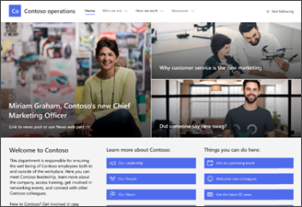
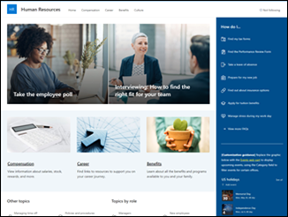
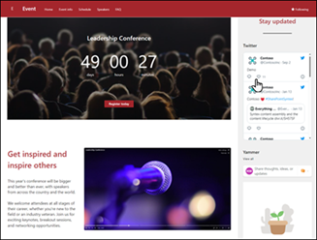
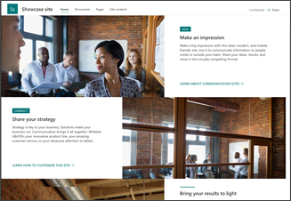
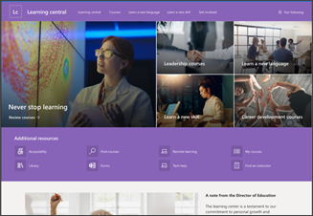
Modern Team sites – site templates
Available Templates:
Crisis management
Department
Human Resources
Event
Leadership Connection
Learning Central
New employee onboarding
Showcase
Topic
Volunteer Center
Blank

Slide 17
When to create a communication sites or a team site
Communication sites:
Team sites:
Use a communication site to broadcast information out to a broad audience.
With a communication site, typically only a small set of members contribute content that is consumed by a much larger audience.
If you want to collaborate with other members of your team or with others on a specific project, a team site is the better choice.
With a team site, typically all or most members can contribute content to the site and the information is limited to only the members of the team or project and specific stakeholders.
Notes:
What does a communication site include?
When you create a communication site in SharePoint Online, you can start with a blank site or choose one of the other site designs, each of which comes with a default set of web parts. The options available are:
Topic to share information such as news, events, and other content.
Showcase to use photos or images to showcase a product, team, or event.
Blank to create your own design.
No matter which one you choose, you can add, remove, or reorder web parts as needed.
If you have permission to edit the site, there's also a link at the top of the communcation site to add a new list, document library, page, news post, or web app to the site.
Topic
When you choose the Topic design, you get a home page that includes several web parts ready for you to customize. The web parts included by default on a Communication site that uses the Topic design are:
Hero: Use the Hero web part to bring focus and visual interest to your page. You can display up to five items in the Hero web part, and you can add compelling images to draw attention to each. For more information, see Use the Hero web part on a modern page.
News: You can keep your team in the loop as well as engage them with important or interesting stories by using the News web part. For more information, see Use News Headlines and News List web parts on a modern page.
Events: Display upcoming events using the events web part. For more information, see Use the Events web part.
Highlighted content: Use the Highlighted content web part to dynamically display content from a document library, a site, a site collection, or all sites. By default, this web part shows your most recent documents. For more information, see Use the Highlighted content web part.
Showcase
The Showcase design also comes with a home page that includes several web parts ready for you to customize. Here are the web parts included by default on a Communication site that uses the Showcase design:
Hero: Use the Hero web part to bring focus and visual interest to your page. With the Showcase design, you can choose from two layouts, Tile and Layer, and add compelling images to draw attention to each item. For more information, see Use the Hero web part on a modern page.

Slide 18
Knowledge Check
Which site template is recommended when provisioning a site collection for collaboration on content?
What are the two modern site templates currently available in SharePoint Online?
Team Site and Communication Site
Team (modern)
Are templates for Team sites and Communication sites the same?
No. Each site type has their own set of templates.

Slide 19
Summary
In this lesson, you learned about:
Modern site templates and designs
When to provision a team site versus a communication site

